Slide 1


Slide 2

Automated
Door
Presented By
Team Trio
Shariar Islam
Id: 0242220005341083
Istewak Hassan Tewak
Id: 0242220005341228
Sourov Hasan
Id: 0242220005341153
What is prototype model?

Slide 3

Presented By
Team Trio
Table of contents
Feature of this system 4
Introduction 5
Motivation 6
System Description 7
System Design (NFA) 9-10
Relevant figures and others 11-12
Conclusion 13-14
Reference 15-16

Slide 4
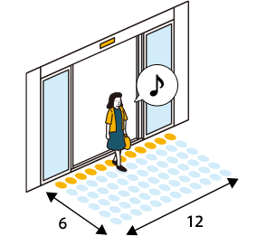
Presented By
Team Trio
Feature of this system
Auto-Lock Mode
Secure-Mode
Remote Control and Monitoring
Customizable
Settings
Energy Efficiency
LED Status Indicators

Slide 5
Presented By
Team Trio
Introduction
This presentation is about a smart door designed for better security and convenience. It works in different states: Locked, Unlocked, Open, Closed, Auto-Lock, and Secure-Mode. I will explain each state in the next slides.

Slide 6
Prototype
Model
Presented By
Team Trio
Motivation
Our smart door system ensures security and convenience. It has Auto-Lock for automatic locking and Secure-Mode to detect threats. It's energy-efficient, using minimal power while keeping homes safe and easy to use.

Slide 7
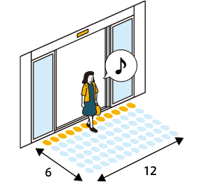
Presented By
Team Trio
Description Of Features
Auto-Lock Mode: Locks the door automatically after being inactive. Remote
Control: Includes a camera and app for monitoring and control. LED Indicators: Shows door status with different colors.
Energy Efficiency: Uses less power with eco-friendly design. Secure-Mode: Detects threats and adjusts security automatically.
Customizable Settings: Lets users set timings and preferences for features.

Slide 8



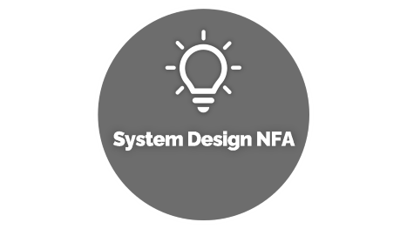






What is prototype model?
Prototype is a dummy which is prepared before start working on the actual project.
It’s a tangible model that allows you to identify your product’s weak and strong points.
it helps you understand the inner workings of your product and make adjustments before you produce an actual product.
Presented By
Team Trio
Automated
Door
Notes:
https://unsplash.com/photos/AXu2aZ3YgP8

Slide 9


System Design NFA

Slide 10


System Design NFA
States :
Open = Q_{0,}Close =Q₁
Alphabets a, b, c, d
1.Front = a
2.Rear = b
3.Both = c
4.Neither = d
b, c, d
a, b, c
a
q₀
q₁
start
d
Notes:
https://unsplash.com/photos/fItRJ7AHak8

Slide 11

Relevant Figures

Slide 12


Relevant Figures
Two states for the door :
-Open
-Close
Possible inputs :
1.Front
2.Rear
3.Both
4.Neither
b, c, d
a, b, c
a
q₀
q₁
start
d
 | Front | Rear | Both | Neither
Open | Open | Open | Open | Close
Close | Open | Close | Close | Close
Notes:
https://unsplash.com/photos/48nerZQCHgo

Slide 13

Conclusion

Slide 14



Conclusion
The Automata Door is a groundbreaking advancement in access control, utilizing finite state machines to provide unparalleled efficiency, security, and user convenience. Its seamless transitions between states and clear LED indicators offer intuitive operation. Key features include intelligent responses to user inputs and environmental conditions, ensuring adaptability in various situations. Enhanced security protocols raise the bar for entry systems, while its robust design and user-friendly interface make it a cornerstone of smart buildings. In essence, the Automata Door represents the epitome of technology and convenience, reshaping access systems and leading the charge towards a more connected and automated future.
Notes:
https://unsplash.com/photos/TvN54bnuQg8

Slide 15

Ending

Slide 16



Ending
Reference: Google, ChatGPT
Notes:
https://unsplash.com/photos/GKLIsLZxhj0

Slide 17
Thank You

